Slide 1
Unit Two
Programming Structure
Vanessa Kasun

Slide 2
Structured Programming
Programming model aimed at improving clarity, quality, and the development time of a computer program.
Does this using structured control flow constructs of selection and repetition, block structures, and subroutines.
Advantages of structured programming
User friendly and easy to understand
Similar to english vocab of words & symbols
Easier to learn
Require less time to write
Easier to maintain

Slide 3
Expressions
Any valid set of...
Literals
Variables
Operators
Expressions that evaluates to a single value
Any unit of code that can be evaluated to a value is an expression. They can appear anywhere in a program where JS expects a value such as the arguments of a function invocation.
JavaScript has the following expression categories:
Arithmetic expression
String expressions
Logical expressions
Primary expressions
Left-hand-side expressions
Assignment expressions
Expressions with side effects
The value may be…
Number
String
Logical value

Slide 4
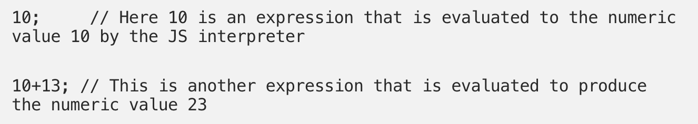
Arithmetic Expressions
Arithmetic expressions evaluates to a numeric value.

Slide 5
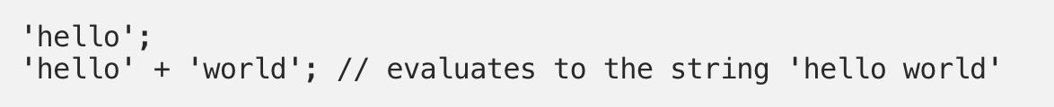
String Expressions
String expressions are expressions that evaluate to a string.

Slide 6
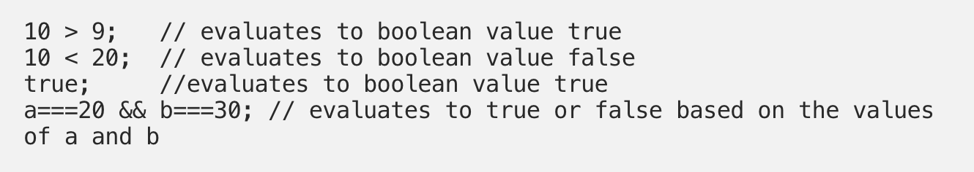
Logical Expressions
Expressions that evaluate to the boolean value true or false are considered to be logical expressions. This set of expressions often involves the usage of logical operators && (AND), ||(OR) and !(NOT)

Slide 7
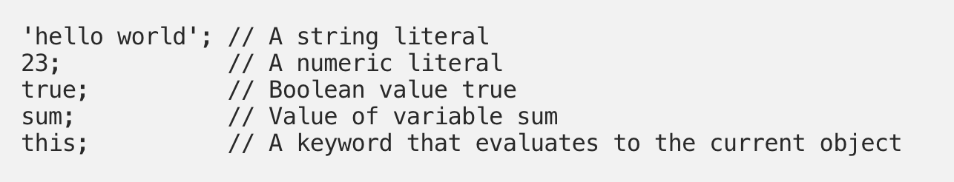
Primary Expressions
Primary expressions refer to stand alone expressions such as literal values, certain keywords and variable values.

Slide 8
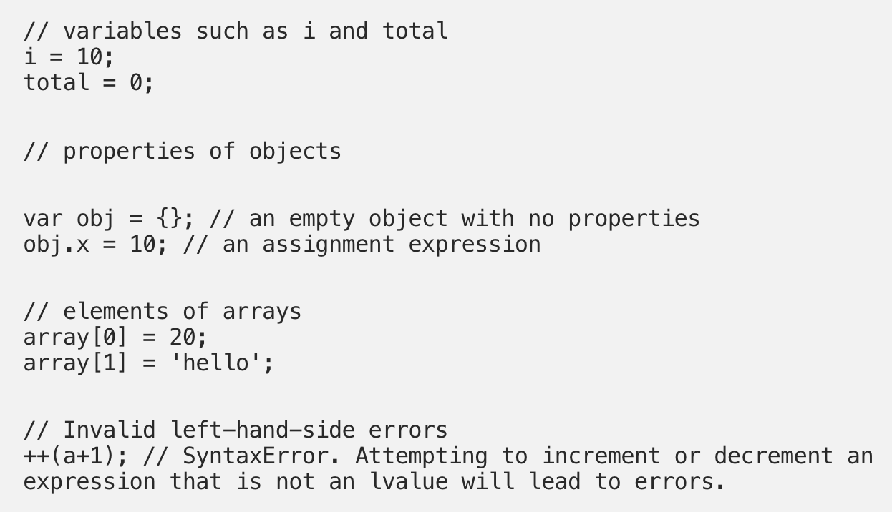
Left-hand-side Expressions
Also known as lvalues, left-hand-side expression are those that can appear on the left side of an assignment expression.

Slide 9
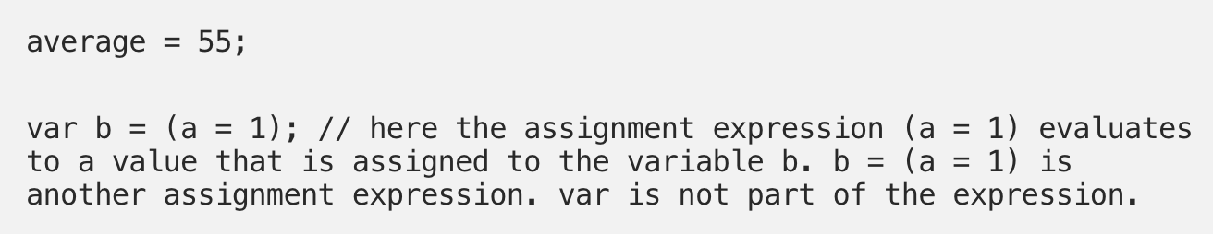
Assignment Expressions
When expressions use the = operator to assign a value to a variable, it is called an assignment expression.

Slide 10
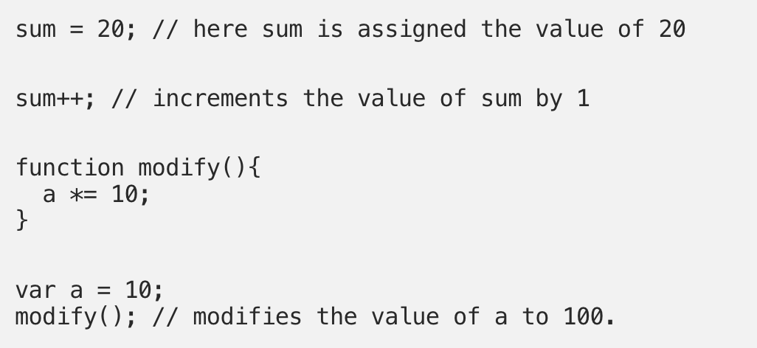
Expressions with side effects
As we just saw with assignment expressions, expressions with side effects are those that result in a change or a side effect such as setting or modifying the value of a variable through the assignment operator =, function call, incrementing or decrementing the value of a variable.

Slide 11
Functions

Slide 12
Structured Programming
Group of related code which can be called anywhere in your program
Eliminates need of writing same code again and again.
Helps with writing modular code
Allows us to divide a big program in a number of small manageable functions.
Function Definition
Before we use a function, we need to define it. We do this by calling the function keyword followed by a function name, a list of parameters(optional), and a statement block surrounded by curly braces.

Slide 13
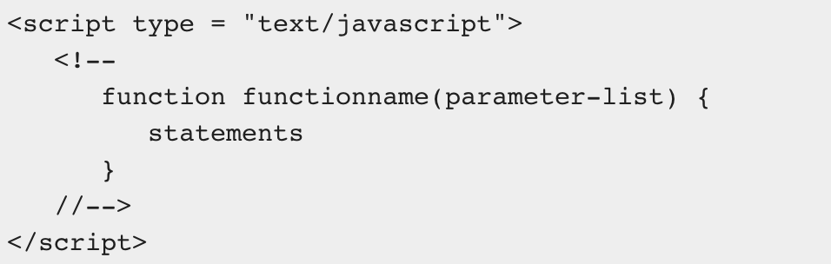
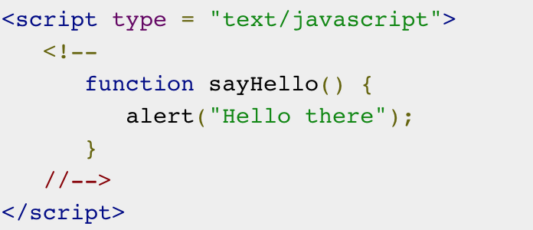
Function Syntax
Example

Slide 14
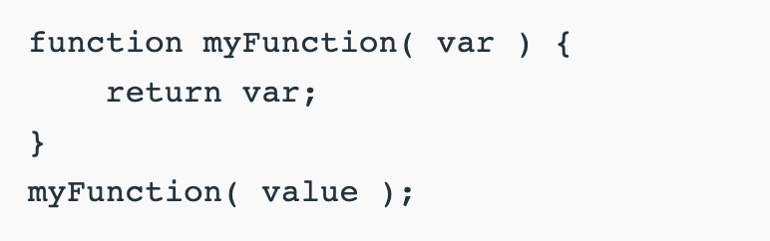

Calling/invoking a function
The difference between calling and invoking is semantic and subtle.
When you call a function, you are directly telling it to run.
When you invoke a function, you are letting something run it.
There is one way to call a function: (here you are invoking the function(letting it run) by calling it directly.
There are many ways to invoke a function
Here is one example:
Here you are calling myFunction and invoking(executing) the code inside

Slide 15
JavaScript Methods

Slide 16
JS Methods
JavaScript methods are actions that can be performed on objects.
A JavaScript method is a property containing function definition.
Property | Value
firstName | John
lastName | Doe
age | 50
eyeColor | brown
fullName | function(){return this.firstName + “” + this.lastName;}

Slide 17



Accessing Object Methods
You can access an object method with the following syntax:
You will typically describe fullName as a method of the person object, and fullName as a property.
The fullName property will execute (as a function) when it is invoked with ().
In the above example we are accessing the fullName method of a person object.

Slide 18


Accessing Object Methods
If you access the fullName property, without (), it will return the function definition:

Slide 19
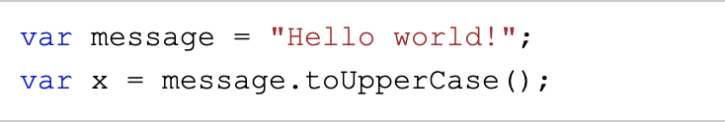

Using Built-In Methods
This example uses the toUpperCase() method of the String object, to convert a text to uppercase:

Slide 20
“This”

Slide 21
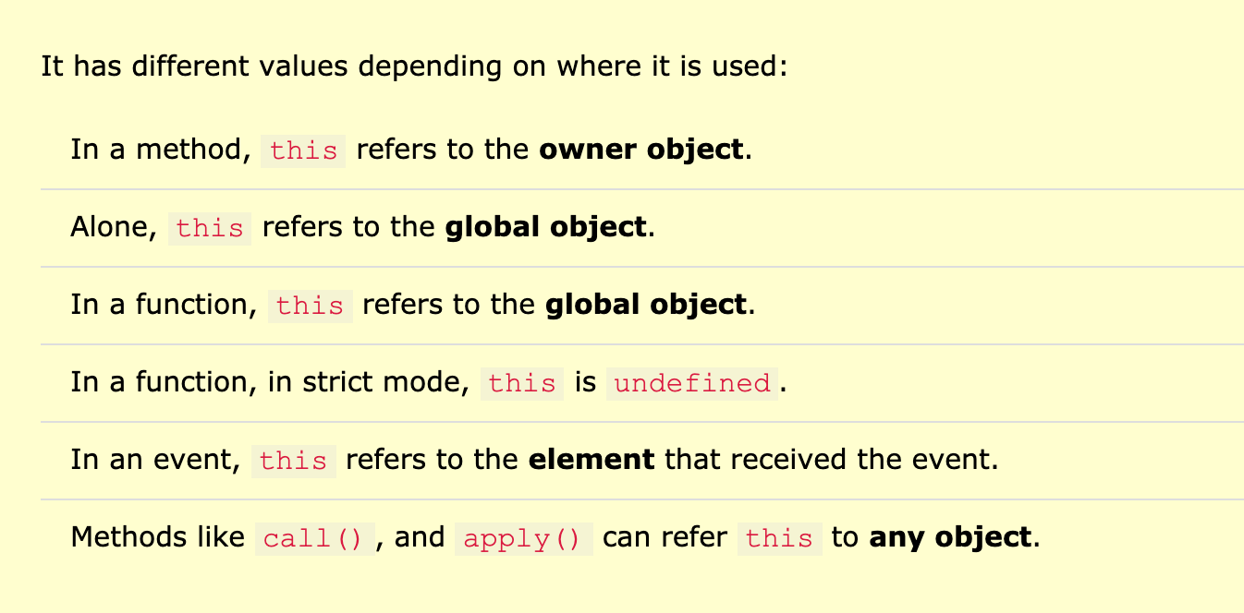
The working mechanism of this is not always easy to understand.
The JavaScript this keyword refers to the object it belongs to.

Slide 22
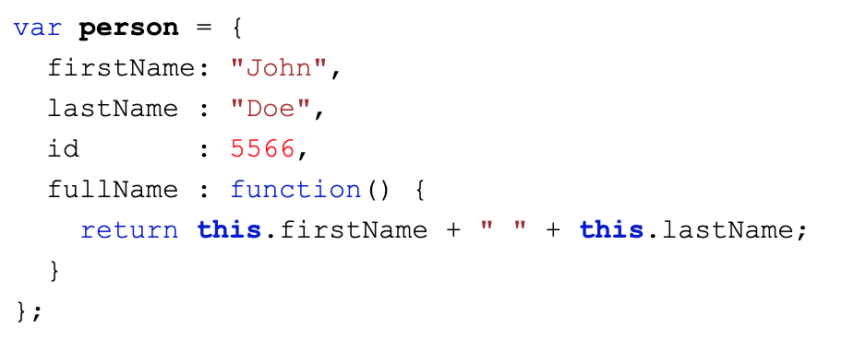
this in a method
In an object method, this refers to the “owner” of the method.
Here this refers to the person object. The person object is the owner of the fullName method.

Slide 23
First, let’s quickly take a look at some examples of objects in our browser window.
Click here to see a list of Global Objects and Global Window Methods

Slide 24

this alone
When used alone, the owner is the Global object, so this refers to the Global object.
In a browser window the Global object us [object Window]:
REMEMBER...
The window object represents an open window in a browser.
If a document contains frames (<iframe> tags), the browser creates one window object for the HTML document, and one additional window object for each.
There is no public standard that applies to the Window object, but all major browsers support it.

Slide 25
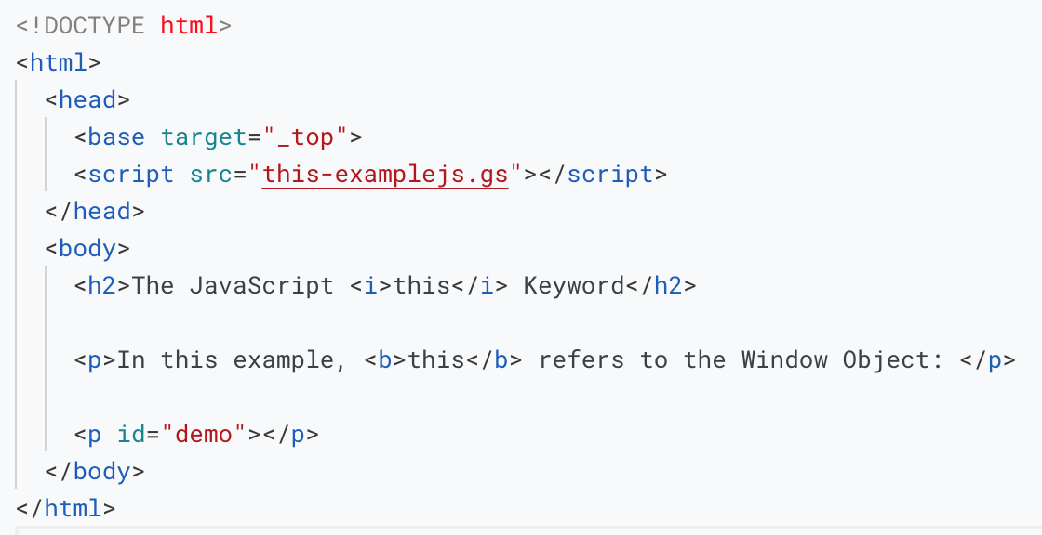
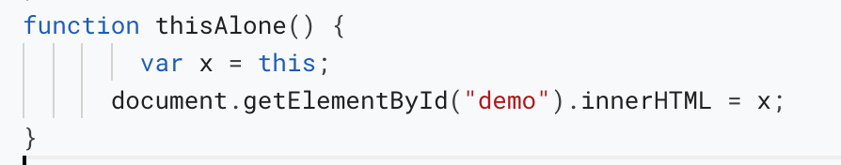
Click here to see the output

Slide 26
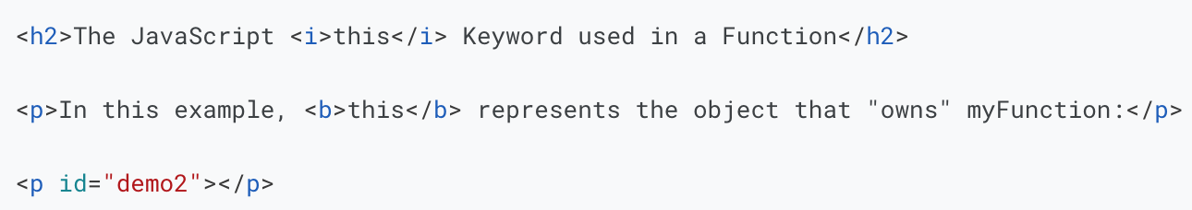
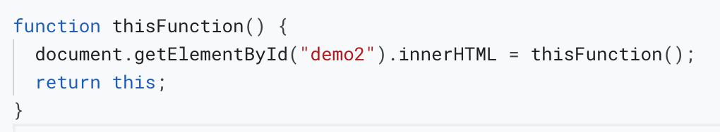
this in a function
Click here to see the output

Slide 27
Lets Practice

Slide 28
Binding

Slide 29
What is binding?
Binding something in JS means recording that identifier in a specific environment record.
Each environment record is related to a specific execution context - and that binds the identifier(variable or function name) to this keyword for that execution context.
Less Formally
Think of Environment Records as buckets of stuff. These are not Objects or Functions or Variables or anything we code in JavaScript, these buckets contain all these things. There are many buckets in a JavaScript application. Each bucket operates independently from the other buckets. That independence is represented as a Context (or Execution Context) in JavaScript. But sometimes we want to use stuff from one bucket inside a different bucket. That is where binding comes in. We can bind stuff from one bucket into the context of a different bucket for execution there. (A side effect of doing all that is the this keyword reflects the bucket borrowing the stuff).

Slide 30
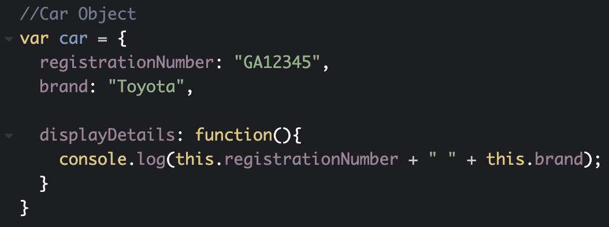
If we want to get the car details, the example below will work perfectly fine as long as we use it this way.

Slide 31
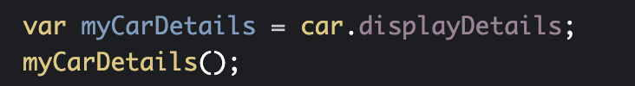
But what if we want to borrow a method?
Well, the above example won’t work as the “this” will now be assigned to the global context which doesn’t have neither the registrationNumber nor the brand property.

Slide 32
To fix this we will use the bind() method. bind() can be used by every single function
The bind() method creates a new function where “this” refers to the parameter in the parenthesis in the above case “car”. This way the bind() method enables calling a function with a specified “this” value.

Slide 33
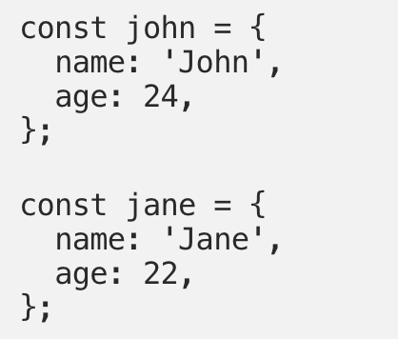
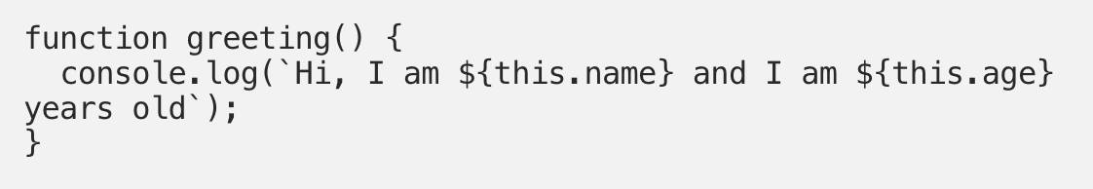
Another example: two person object
Now let’s add a greeting function:

Slide 34
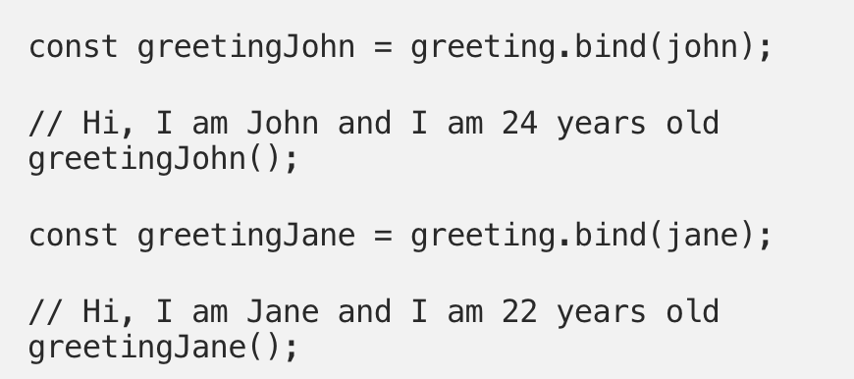
We can use the bind method on the greeting function to bind the this keyword to john and jane objects. For example:
Here greeting.bind(john) creates a new function with this set to the john object, which we then assign to the greetingJohn variable. Similarly, for greetingJane.

Slide 35
Applying a function
The apply() method, invokes a function with a given “this” value and arguments provided as an array. Applying is similar to calling except that it accepts the arguments of the function as an array instead of an individual argument.
Call VS Apply

Slide 36
Accessing functions without () /parameters and return types

Slide 37
Remember, console.logging something just prints information to the console.
The computer cannot make use of that logging.
Return on the other hand is a call to pass some value back up to where the call was made
Take a look at this example for a refresher

Slide 38
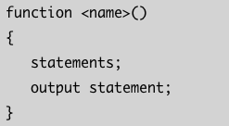
This is the syntax for a function which doesn’t have parameters and also does not return any value.
Function - the keyword function identify the block as a function object.
<name> - is the name of the function given by a user.
() - parenthesis does not contain any argument
Statements - all javascript statements that get executed by the function.
Output statement - it is NOT necessary that a function that does not return anything must give an output, but most of the time you will find a statement that prints the output in these types of functions.

Slide 39
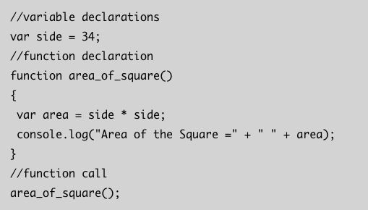

Consider this example
The variable side is not given to the parameter, but directly accessed by the function which is possible in JavaScript
The function does not return any value but prints the output to the browser console.

Slide 40
Unit 2 Part II

Slide 41
Control Flow
The control flow is the order in which the computer executes statements in a script.
Code is run in order from the first line in the file to the last line, unless the computer runs across the (extremely frequent) structures that change the control flow, such as conditionals and loops

Slide 42
Conditional Statements
Very often when we write code, you want to perform different action for different decisions.
You can use conditional statements in your code to do this.
In JavaScript we have the following conditional statements:
If
Else
Else if
Switch (we will talk about this briefly)

Slide 43



The if Statement
Use the if statement to specify a block of JS code to be executed if a condition is true.
Syntax
Example
Make a “Good Day” greeting if the hour is less than 18:00:

Slide 44
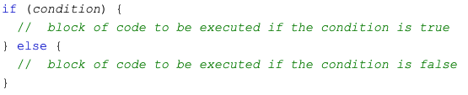
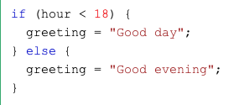
The else Statement
Use the else statement to specify a block of JS code to be executed if a condition is false.
Syntax
Example
If the hour is less than 18, create “Good day” greeting, otherwise “Good evening”:

Slide 45
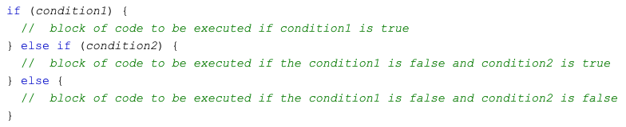
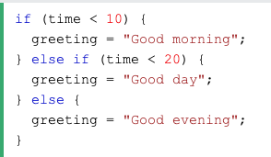
The else/if Statement
Use the else/if statement to specify aa new condition if the first condition is false.
Syntax
Example
If time is less than 10:00, create a "Good morning" greeting, if not, but time is less than 20:00, create a "Good day" greeting, otherwise a "Good evening":

Slide 46
Let’s Practice

Slide 47
JavaScript Loops

Slide 48
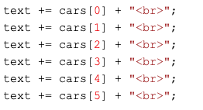

Loops are handy, if you want to run the same code over and over again, each time with a different value.
Often this is the case when working with arrays,
instead of writing: you can write:

Slide 49
Different Kinds of Loops
JavaScript supports different kinds of loops:
for - loops through a block of code a number of times
for/in - loops through the properties of an object
for/of - loops throup the values of an iterable object
while - loops through a block of code while a specified condition is true
do/while - also loops through a block of code while a specified condition is true

Slide 50

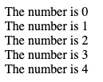

The For Loop
for loop has the following syntax:
Statement 1 is executed (one time) before the execution of the code block.
Statement 2 defines the condition for executing the code block.
Statement 3 is executed (every time) after the code block has been executed.
Example:

Slide 51
Statement 1 sets a variable before the loop starts (var i = 0).
Statement 2 defines the condition for the loop to run (i must be less than 5).
Statement 3 increases a value (i++) each time the code block in the loop has been executed.

Slide 52
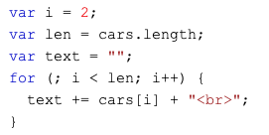

Let’s talk about it...
Statement 1
Normally you will use statement 1 to initialize the variable used in the loop (i=0).
This is not always the case, JavaScript doesn’t care. Statement 1 is optional.
You can initiate many values in statement 1 (separated by comma) and you can omit statement 1 (like when your values are set before the loop starts):

Slide 53
Let’s talk about it...
Statement 2
Often statement 2 is used to evaluate the condition of the initial variable.
This is not always the case, JavaScript doesn’t care. Statement 2 is optional.
If statement 2 returns true, the loop will start over again, if it returns false, the loop will end.
**If you omit statement 2, you must provide a break inside the loop. Otherwise the loop will never end. This will crash your browser. **

Slide 54
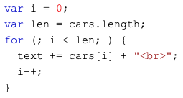
Let’s talk about it...
Statement 3
Often statement 3 increments the value of the initial variable..
This is not always the case, JavaScript doesn’t care. Statement 3 is optional.
Statement 3 can do anything like negative increments(i--), positive increments (i = i +15), or anything else.
Statement 3 can also be omitted (like when you increment your values inside the loop):

Slide 55
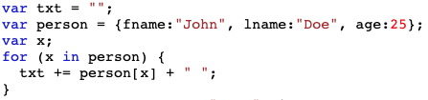

Example of for...in loop
In this example we have two variables. One is assigned to an empty string and the other is assigned to the value of x.
We also have a person object with a first and last name along with an age.
X is acting as a “placeholder”(key) for the values in the object, so when we say (x in person) we are saying the properties of person.
We know the += operator is a shorthand for (value = value + value). So this is saying…
“ ” + fname + “ ” = John
“ ” + name + “ ” = Doe
“ ” + age + “ ” = 25
Which is equal to
John Doe 25

Slide 56
Let’s Practice

Slide 57
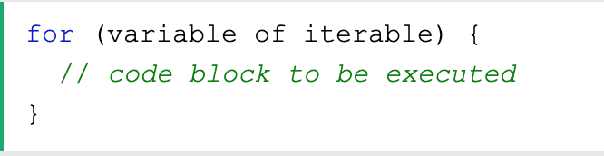
For/Of Loop
The JavaScript for/of statement loops through the values an iterable object.
It lets you loop over iterable data structures like Arrays, Strings, Maps, NodeList, and more:
Syntax
Variable - for every iteration the value of the next property is assigned to the variable. Variable can be declared with const, let, or var.
Iterable - an object that has iterable properties

Slide 58
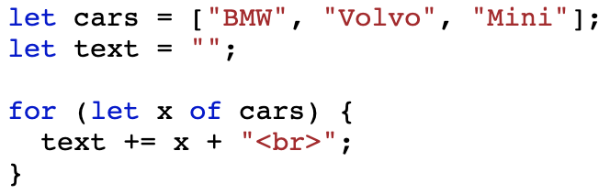
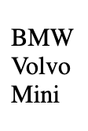
Looping over an Array Example
Here we an array named cars with three string values.
A variable named text assigned to an empty string.
The for/of loop is setting the value of x (let x)to the values in the Car array(of cars) and printing out the values. (text += x + “<br>”;)

Slide 59
Let’s Practice

Slide 60
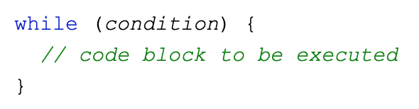
The While Loop
The while loop, loops through a block of code as long as a specified condition is true.
Syntax

Slide 61
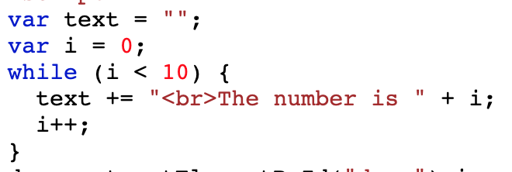
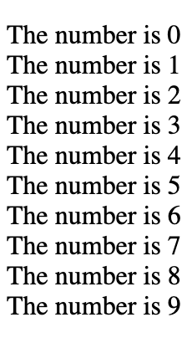
While Loop Example
The while statement evaluates the expression before each iteration of the loop.
If the expression evaluates to true, the while statement executes the statement. If the expression evaluates to false, execution continues with the statement after the while loop.
The while loop evaluates the expression before each iteration, therefore, the while loop is known as a pretest loop. For this reason, it is possible that the statement inside the while loop is never executed.

Slide 62
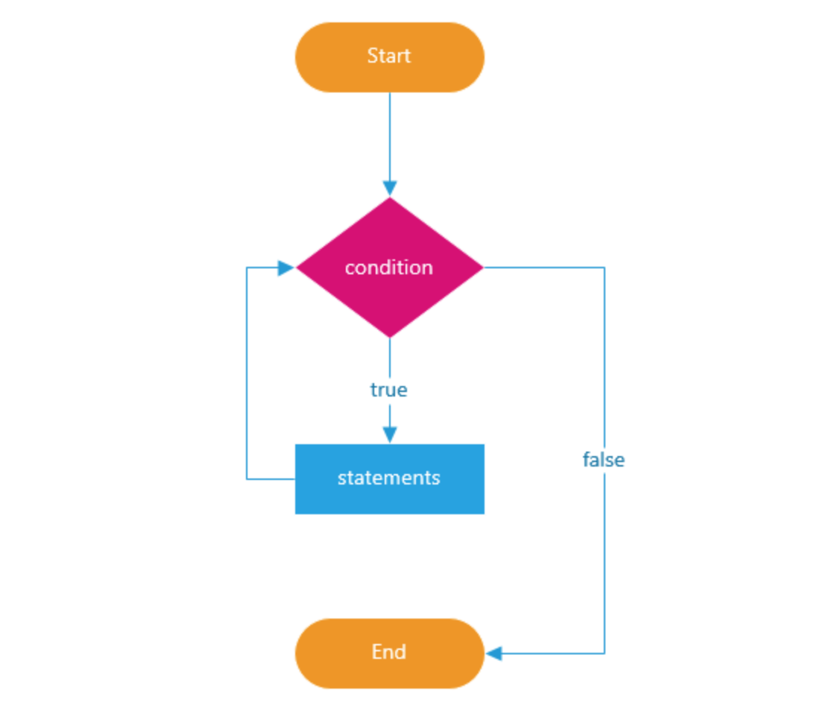
The following illustrates the while loop statement

Slide 63
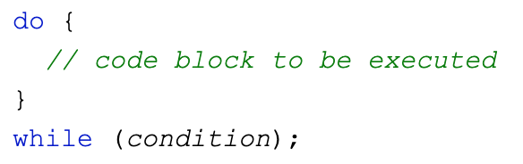
The Do/While Loop
The do/while loop is a variant of the loop. This loop will execute the code block once, before checking if the condition is true, then it will repeat the loop as long as the condition is true.
Syntax

Slide 64
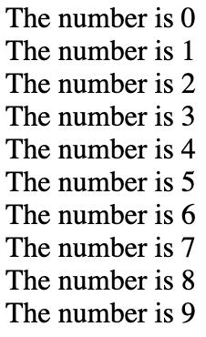
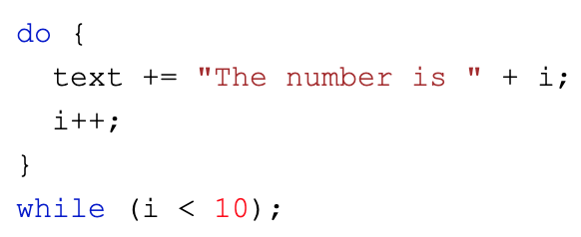
Do/While Loop Example
The example below uses a do/while loop. The loop will always be executed at least once, even if the condition is false, because the code block is executed before the condition is tested.

Slide 65
So what is the difference between the while loop and the do/while loop?
So, remember the While loop condition is tested at the beginning of the loop, and if the condition is True, statements inside the loop will execute.
Which means the While loop executes the code block only if the condition is True…
At the end of the loop, the Do While loop tests the condition. So, Do While executes the statement in the code block at least once even if the condition Fails.

Slide 66
Let’s Practice

Slide 67
Break and Continue

Slide 68
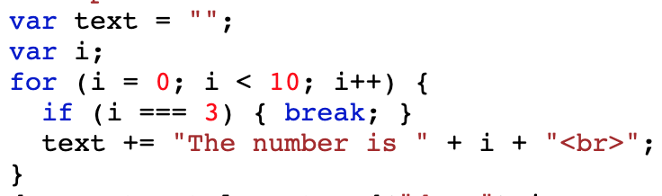
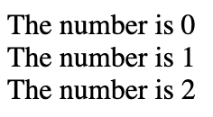
The Break Statement
A loop with a break statement
The break statement “jumps out” of a loop.
The continue statement “jumps over” one iteration of the loop.
In this example, the break statement ends the loop (“breaks” the loop) when the loop counter (i) is 3.

Slide 69
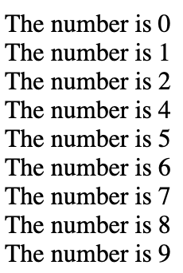
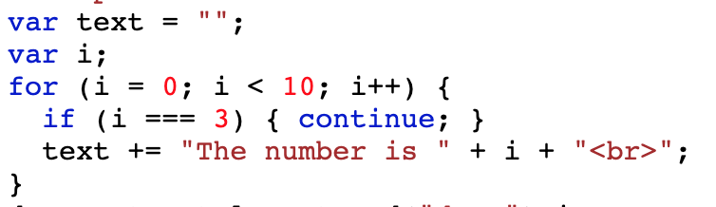
The Continue Statement - breaks on iteration (in the loop), if a specified condition occurs, and continues with the next iteration in the loop.
A loop with a continue statement
This example skips the value of 3

Slide 70
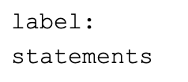
JavaScript Labels
A label can be used with a break or continue statement to control the flow of the code more precisely. The label is applied to a block of code or a statement.
To label JavaScript statements you precede the statements with a label name and a colon.
JavaScript label is a statement used to prefix a label as an identifier. You can specify the label by any name other than the reserved words.
Syntax

Slide 71
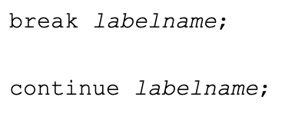
The break and continue statements are the only JavaScript statements that can “jump out of” a code block.
Syntax
The continue statement(with or without a label reference) can only be used to skip one loop iteration.
The break statement, without a label reference, can only be used to jump out of a loop or switch.
With a label reference, the break statement can be used to jump out of any code block.

Slide 72
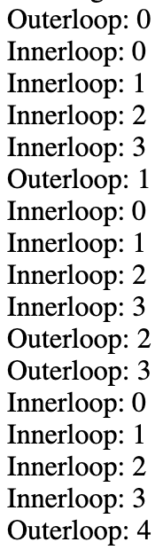

Example - using labels to control the flow, with break statement

Slide 73


Example - using labels to control the flow, with continue statement

Slide 74
Let’s Practice

Slide 75
Switch Statements

Slide 76

Switch Statements are used to perform different actions based on different conditions.
Use the switch statement to select one of many code blocks to executed.
Syntax
This is how it works:
The switch expression is evaluated once.
The value of the expression is compared with the values of each case.
If there is a match, the associated block of code is executed.
If there is no match, the default code block is executed.

Slide 77

An Example
Here the switch starts to compare a from the first case variant that is 3. The match fails.
Then 4. That’s a match, so the execution starts from case 4 until the nearest break.
If there is no break then the execution continues with the next case without any checks.

Slide 78
Break Keyword
When JavaScript reaches a break keyword, it breaks out of the switch block.
This will stop the execution inside the switch block.
It is not necessary to break the last case in a switch block. The block breaks (ends) there anyways.
Note: If you omit the break statement, the next case will be executed even if the evaluation does not match the case.

Slide 79


Default Keyword
The default keyword specifies the code to run if there is no case match.
Example
If today is neither Saturday (6) nor Sunday(0), write a default message.
**The getDay() method returns the weekday as a number between 0 and 6.
The default case does not have to be the last case in a switch block.
--If default is not the last case in the switch block, remember to end the default case with a break.
Output

Slide 80

Common Code Blocks
Sometimes you will want different switch cases to use the same code.
In this example case 4 and 5 share the same code block, and 0 and 6 share another code block.
Example
**The getDay() method returns the weekday as a number between 0 and 6.
Output

Slide 81
Switching Details
If multiple cases matches a case value, the first case is selected.
If no matching cases are found, the program continues to the default label.
If no default label is found, the program continues to the statement(s) after the switch.
Strict Comparison
Switch cases use strict comparison (===)
The values must be of the same type to match,
A strict comparison can only be true if the operands are of the same type.

Slide 82


Example
Output

Slide 83
Whoa. That was a lot! Let’s Practice & Keep moving forward!

